Slide 1

How to create an early-stage pitch deck.
Ryan Spoon: ryanspoon.com Polaris Venture Partners: polaris.vc Dogpatch Labs: dogpatchlabs.com

Slide 2
























About Us: Sample Companies

Slide 3
Intro
I’ve seen 1,000s of early stage decks over last 2 yrs
Most mistakes are relatively common
And most mistakes are easily addressed
This is a guide to creating your pitch deck
Warning: it’s just one investor’s advice :)
Two parts to this walkthrough:
1. Five overarching guidelines
2. An example structure & flow

Slide 4
Five Themes / Guidelines

Slide 5
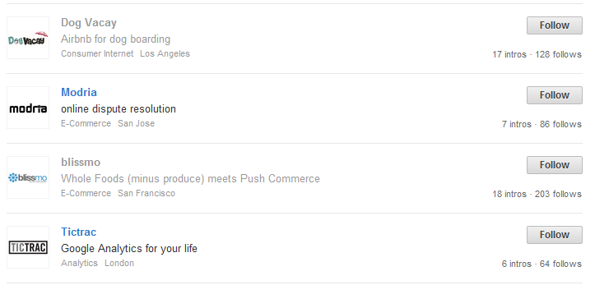


1. A Great One-Liner
Think of it as your elevator pitch… in one sentence.
It’s a hybrid of:
- Your product / vision
- Your company purpose
- A starting point for the pitch
Common framework: “We are X for Y”* *assuming X is attractive and Y is a big enough opportunity!

Slide 6
2. Know Your Audience
Before crafting a pitch deck, understand:
Who you are meeting with?
What is the investor’s and the firm’s focus?
Are there related investments?
How much time do you have?
These influence your deck, the discussion and likely questions you’ll be asked.

Slide 7
3. 10-15 Slides
The deck is important... But the conversation is more important.
Budget your time accordingly. Allow for discussion alongside each slide.
10-15 slides. Max. Will provide suggested structure later in deck

Slide 8
4. Beware the Demo
For early stage companies, it’s all about product.
And the best mark of product is market validation.
Demos are great… but remember these four rules:
Be careful of time.
Don’t get lost in product.
Have backup if (when!) something goes wrong.
Give even weight to product & traction / data.

Slide 9
5. Expect the Deck to be Shared
Whether you like it or not (!), your deck will be shared (i.e. among partnership). Goal: be equally compelling with/without voiceover.
How?
- deck should tell its own story. - do *not* rely on builds, intricate slides. - make the file size manageable for email. - PDF or secure URL are great alternatives to PPT.

Slide 10
Suggested Structure. (remember: 10-15 slides)

Slide 11
The Flow
The Big Idea
Your solution. Why now?
The current problem
Traction & validation
Why you?
The ask
What’s the future?

Slide 12
Remember: 10-15 Slides
The Big Idea
Your solution. Why now?
The current problem
Traction & validation
Why you?
The ask
What’s the future?
1-2 slides
1 slide
2-4 slide
3-5 slides
2-4 slides
1-2 slide
1 slide

Slide 13
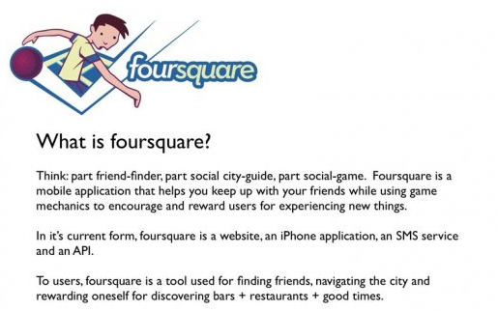
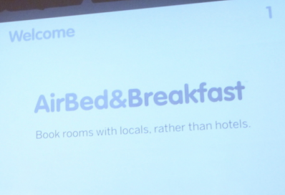
1. Vision
The Big Idea
- Expanded company one-liner - The big vision: today & tomorrow
http://www.businessinsider.com/this-is-the-first-pitch-deck-foursquare-ever-showed-investors-2011-12?op=1
http://www.businessinsider.com/airbnb-a-13-billion-dollar-startups-first-ever-pitch-deck-2011-9#-1

Slide 14
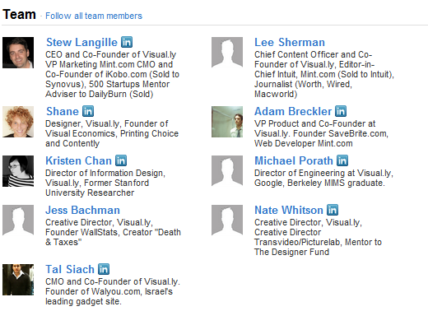
2. The Team
Why are you the right team for the problem?
- Include management team and advisors, investors - Include bios with key, relevant experience - Outline division of responsibilities
Think an expanded AngelList team profile
http://angel.co/visually

Slide 15
3. The Market… 4. The Opportunity
Your solution
The current problem
Why now?
- Customer / consumer pains? - How are they solving today?
- How will they solve with you? - How is it different than market?
- Why is solution possible today? - Why is it right for today, tomorrow?
- How big is the market? - How big can you be? - What value are you creating?
- Be realistic!

Slide 16
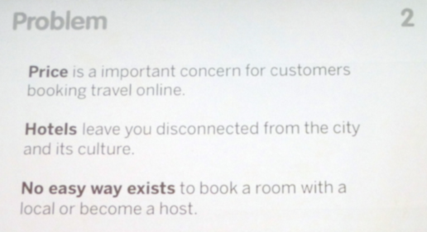
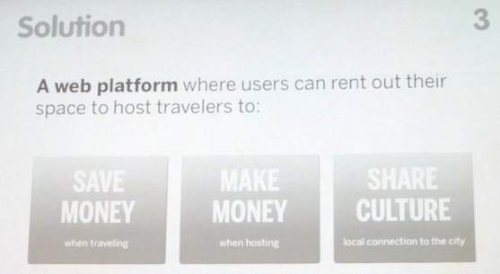
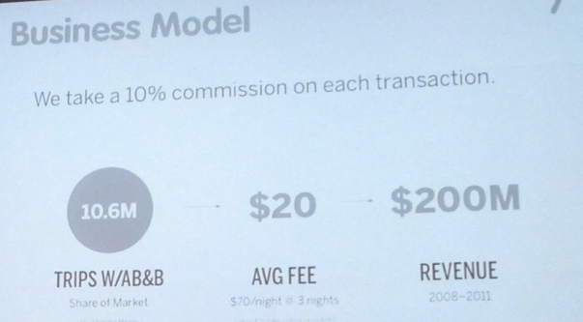
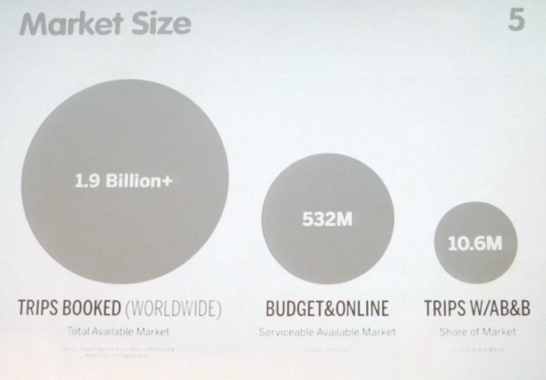
Airbnb: Problem, Solution, Market Size, Market Potential

Slide 17
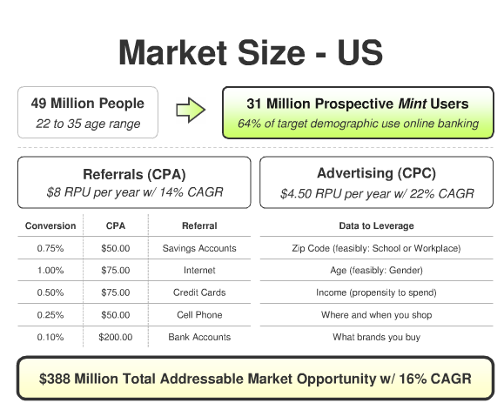
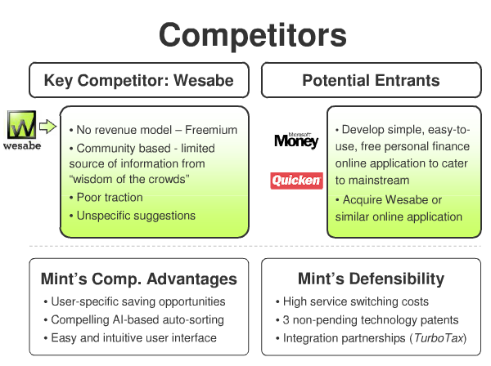
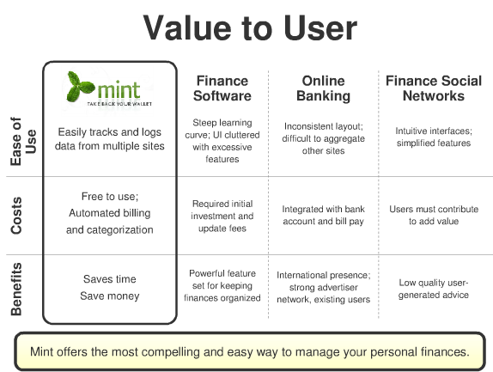
Mint: Market size, Landscape, Product / Market Fit

Slide 18
5. Your Product…. 6. Your Traction
You’ve set the stage… now show off the product and traction / validation:
I want to know: - is the product resonating? - is it trending in the right direction?
- engagement, engagement, engagement
engagement data > user acquisition!
- What are your KPIs? Goals?

Slide 19
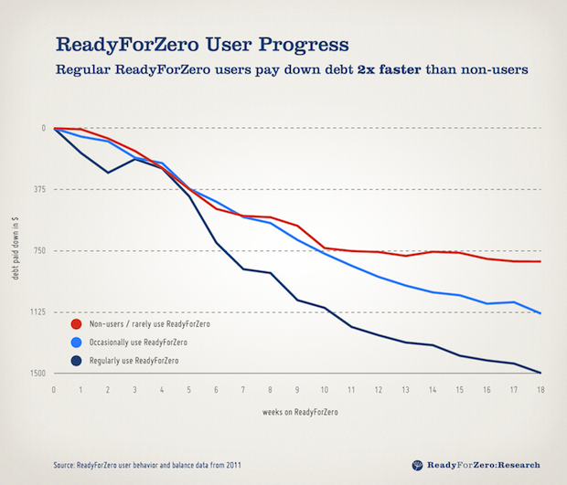
ReadyForZero: Product Traction
Traction can be shown through acquisition, usage, retention, etc.
ReadyForZero showed user activity as measure of product efficacy:
Users pay-off debt 2x faster than non-users

Slide 20
7. The Future: 12mo & Out
So far, you’ve spent the deck outlining team, product and success to-date. Now talk about what’s next… And how it ties into the big vision and the fundraise.
What are the next 12-24 months of: - Product - People - Performance - Finances

Slide 21
8. The Ask
A pitch deck cannot crescendo without a clear ask (aka what you are looking for):
What size investment are you looking for?
How long does it get you?
How will you spend it?
What are goals before raising the next round?
How else can the investor(s) help?
This is commonly overlooked… but easy to create!

Slide 22





Learn more. Connect with us.
polaris.vc @polarisvc fb.com/polarisventures
dogpatchlabs.com @dogpatchlabs fb.com/dogpatchlabs
ryanspoon.com @ryanspoon fb.com/ryanspoon

